Slide 1
Chapter 14: Pricing

Slide 2
Marketing Strategy Overview – Basic Structure
Analyze the environment and set the strategy
Company
(strengths & weaknesses)
Customers
Segment the market
Target your customers
Position your product
Competition
Product
Price
Promotion
Place
Leveraging real tools to implement strategic objectives

Slide 3
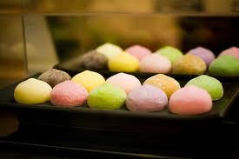
How much are you willing to pay?
Imagine you are introducing Mochi Ice Cream
Bites of premium ice cream wrapped in a paper-thin sheet of chewy mochi rice cake
How much do you think grocery stores charge? How much would you pay (assuming you find the product appealing)?

Slide 4
Different Prices for Same Product
Trader Joe's vs. Central Market
Both sell high-end goods
Bubbies Mochi Ice Cream:
TJ's sells the box of 9 pieces for $2.99;
Central Market sells the same for $7.99

Slide 5
Preview
Steps to setting a price
Pricing approaches

Slide 6
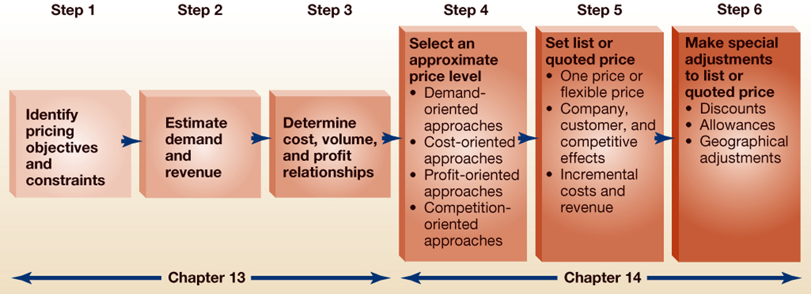
6 Steps of Setting Price

Slide 7
Setting the Price of Products
Based on the product costs and marketplace factors, a manager sets the final price using…
4 Approaches to setting price level
Demand-Oriented Pricing
Cost-Oriented Pricing
Profit-Oriented Pricing
Competition-Oriented Pricing

Slide 8
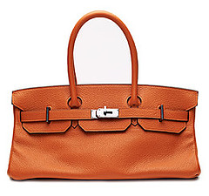
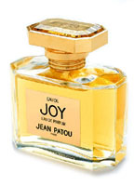
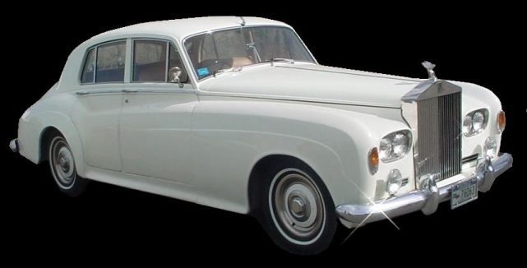
Setting the Price of Products
4 Approaches to setting price level
Demand-Oriented Pricing
Weighs factors underlying expected customer tastes and preferences more heavily than such factors as cost, profit and competition

Slide 9
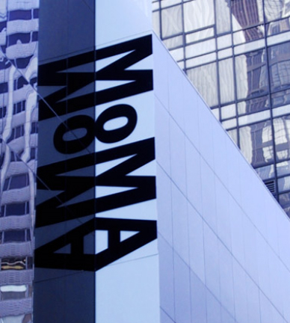
Setting the Price of Products
4 Approaches to setting price level
Cost-Oriented Pricing
Price setter stresses the cost side of the pricing problem (not the demand side)

Slide 10
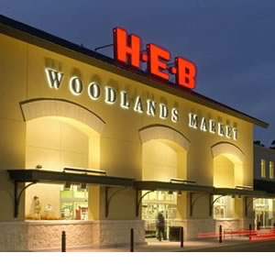
Setting the Price of Products
4 Approaches to setting price level
Profit-Oriented Pricing
Balances revenues and costs to set price at profit maximizing point
Notes:
Supermarkets set prices in order to achieve a specific return-on-sales pricing

Slide 11


Setting the Price of Products
4 Approaches to setting price level
Competition-Oriented Pricing
Vs.
Price setter focuses on what competitors or “the market” is doing

Slide 12
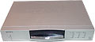
Demand-Oriented Approaches
Skimming Pricing
A firm introduces a new or innovative product at a high initial price that only customers who REALLY desire the product would pay
Penetration Pricing
Prestige Pricing
September 26, 1996 - Toshiba announces first home DVD player SD-3000 ($674).
Price Lining

Slide 13
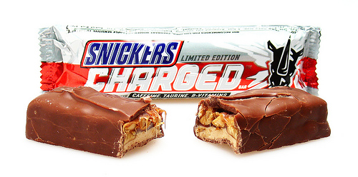
Demand-Oriented Approaches
Skimming Pricing
Penetration Pricing
Setting a low initial prices on a new product to appeal immediately to mass market
Snickers Charged boasts 60 milligrams of caffeine, taurine and other B vitamins (about 10% of your RDA).
Prestige Pricing
Price Lining
Introductory price: $.75

Slide 14
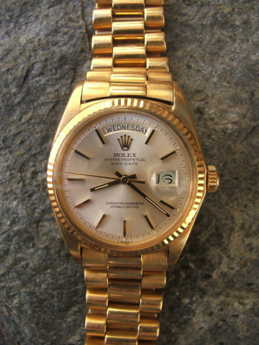

Demand-Oriented Approaches
Skimming Pricing
Penetration Pricing
Prestige Pricing
Setting price so high that quality or status-seeking customers will be attracted to the product and buy it.
Price Lining

Slide 15
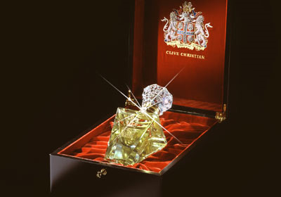
Most Expensive Perfume in the World
Imperial Majesty, which costs $215,000 a bottle, is the most expensive perfume in the world.
Would it smell as sweet at any other price?

Slide 16
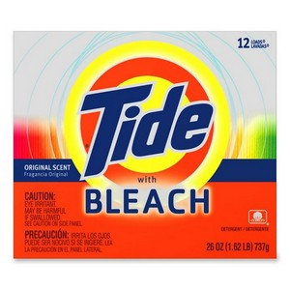
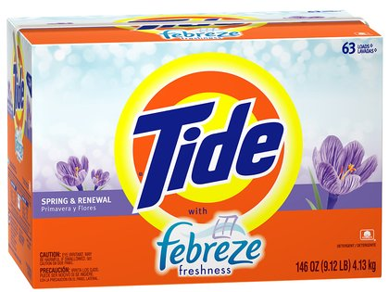
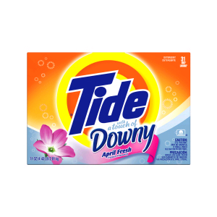
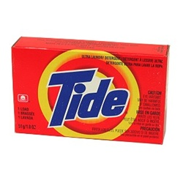
Demand-Oriented Approaches
Skimming Pricing
Penetration Pricing
Prestige Pricing
Price Lining
If a firm is selling a line of products, they set the prices of products that are alike in size, ingredients etc. at the same level
How can P&G Line Price these products?

Slide 17
Demand-Oriented Approaches
Odd-Even Pricing
Setting the price a few dollars/cents below an even number to signal a discount or lower price
Target Pricing
Q: Is ODD or EVEN pricing more likely to be a sale price?
Bundle Pricing
Yield Management Pricing
Is $19 or $19.99 a sale price?

Slide 18
Odd-Even Pricing
Article: Why There Are More .300 Hitters Than .299 Hitters, And Why It Matters…

Slide 19
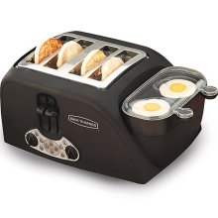
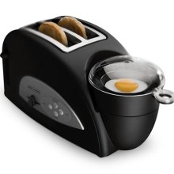
Demand-Oriented Approaches
Odd-Even Pricing
Target Pricing
Estimating what the customer is willing to pay and working backwards to create a product that matches this price
$51.00
$25.00
If people won’t pay $51, they might pay $25
Bundle Pricing
Yield Management Pricing

Slide 20
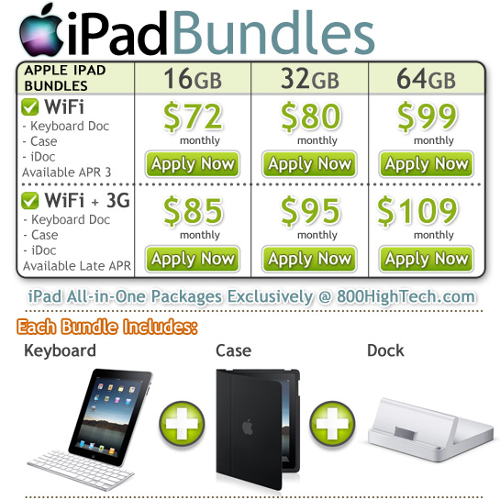
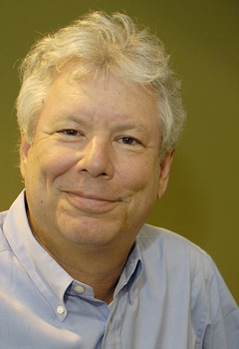
Demand-Oriented Approaches
Odd-Even Pricing
Target Pricing
Bundle Pricing
The marketing of two or more
products in a single package price
Segregate gains and integrate losses
- Richard Thaler
Yield Management Pricing

Slide 21
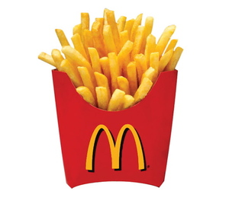
Demand-Oriented Approaches
Odd-Even Pricing
Target Pricing
Bundle Pricing
Yield Management Pricing
Charging different prices to maximize revenue for a set amount of capacity occupied at any given time.
McDonalds has 6 – 8 pricing strategies within O’Hare airport – that means that a burger can range in price from $1. 50 - $2.50+

Slide 22
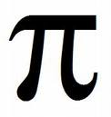
Cost-Oriented Approaches
Standard Markup Pricing
Variable and fixed costs per unit are estimated, and a standard
markup is added.
+
Cost-Plus Pricing
Experience Curve Pricing

Slide 23
Cost-Oriented Approaches
Standard Markup Pricing
Cost-Plus Pricing
Variation of standard mark-up pricing. Summing the total unit cost of providing a product or service and adding a specific additional amount (relating to the $$ for the customized aspect of the product) to arrive at a price. Used for one-of-a-kind items
Experience Curve Pricing

Slide 24
Cost-Oriented Approaches
Standard Markup Pricing
Cost-Plus Pricing
Experience Curve Pricing
Prices declines because the unit cost of product or service declines as the firm’s experience at producing or selling it doubles

Slide 25
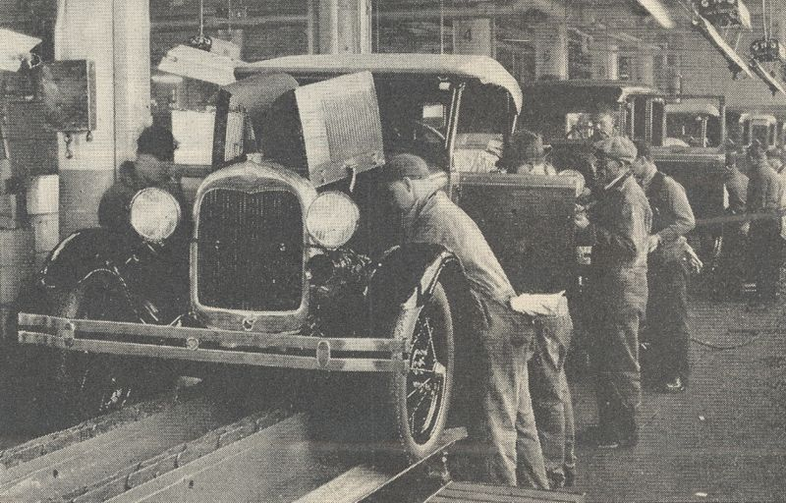
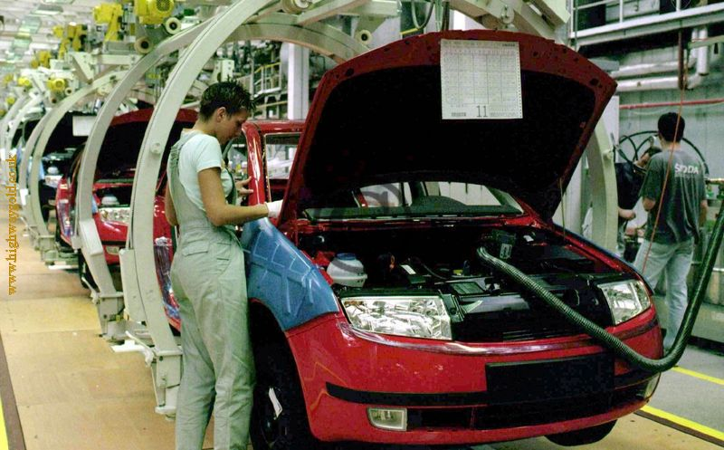
Increasing Efficiency

Slide 26
Profit-Oriented Approaches
Fill in your
costs
and
quantity
and solve
for Price
Target Profit Pricing
Firm sets an annual target of a specific $ volume of profit
Profit = Total Revenue – Total Cost
Profit = (P x Q) – [FC + (UVC x Q)]
Unit Variable cost is a constant $11 per unit
Fixed cost is a constant $45,000
Demand is insensitive to price up to $100 per unit
A target profit is sought of $9000 at an annual volume of 2,000 products
9,000 = (P x 2,000) – [45,000 + (11 x 2000)]
67,000+ 9,000 = 2,000P – [45,000+22000] + 67,000
76,000/ 2,000 = 2,000P / 2,000
$38 = Price

Slide 27
Profit-Oriented Approaches
One drawback of Target Profit Pricing is there is no benchmark of sales or investment used to show how much of the firm’s effort is needed to achieve the target
Target Profit Pricing
Target Return-On-Sales Pricing
Set prices that will give them a profit that is a specified percentage of sales volume – this is a measure of how much effort/sales is needed to achieve this target
Target Return on Sales = Target Profit / Total Revenue
Unit Variable cost is a constant $11 per unit
Fixed cost is a constant $45,000
Target sets a 20% return on sales at annual volume of 3000 units
Fill in your
costs
and
quantity
and solve
for Price
20% = (TR – TC)/ TR
.20= (P x Q) – [FC + (UVC x Q)]/ TR
.20 = (P x 3,000) – [45,000 + (11 x 3000)]/ P x 3000
(3000P) * .20 = 3000P – [78,000] * (3000P)
3000P
.2 * 3000P = 3000P – 78000
600P – 3000P = 3000P – 78000 – 3000P
- 2400P (1/ 2400)= -78000 (1/ 2400)
P = $32.5

Slide 28
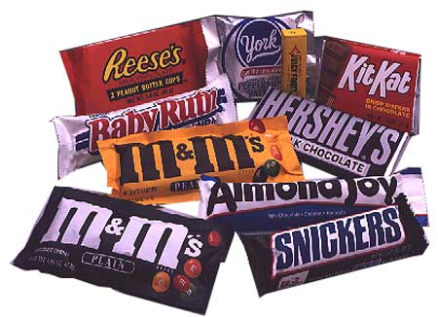
Competition-Oriented Approaches
Customary Pricing
Some products, where tradition, a standardized channel of distribution or other competitive factors dictate price, this type of pricing is used.
How do they raise prices???
Above-, At-, or
Below-Market Pricing
Loss-Leader Pricing

Slide 29
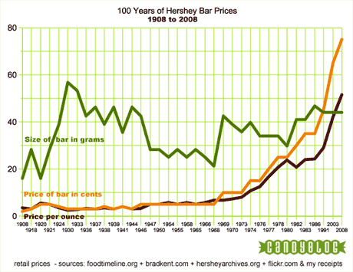
Size of Chocolate Bars
through the early years the price of the bar increased steadily (though slowly) but the size of the bar sold was volatile
The bar did become a better value quite often, both growing in size and dropping in price
Often when the price went up, so did the size of the bar as a way to offset the perception of poor value.
However, the trend in the past 20 years has been to keep the bar the same size but simply raise the prices as needed.

Slide 30
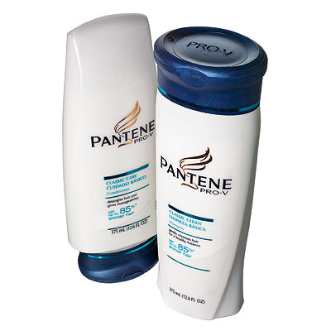
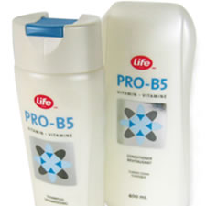
Competition-Oriented Approaches
Customary Pricing
Above-, At-, or
Below-Market Pricing
Sometimes it’s difficult to identify a specific market price for competing products. Marketing managers will have a subjective feel for these prices and set their products’ at or above or below these prices
Loss-Leader Pricing

Slide 31
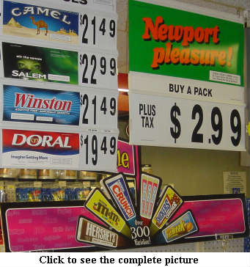
Competition-Oriented Approaches
Customary Pricing
Above-, At-, or
Below-Market Pricing
Loss-Leader Pricing
Special promotion that a retailer might run to
deliberately sell one product below its customary price to attract attention and attract attention, hopefully generating other sales.

Slide 32
Step 5: Set the List or Quoted Price
One-Price Policy (Fixed Pricing)
One price for all buyers
Flexible-Price Policy (Dynamic Pricing)

Slide 33
Step 5: Set the List or Quoted Price
One-Price Policy (Fixed Pricing)
Flexible-Price Policy (Dynamic Pricing)
Setting different prices for products and services depending on individual buyers and purchase situations
http://online.wsj.com/article/SB117522181197454106.html
One patron spent $500 a night for an ocean-view room at the El Dorado Royale on the Riviera Maya in Mexico last month, was constantly reminded of her lesser standing during her two-night stay. Guests in the resort's Casita suites, which cost about 50% more, have private pools, exclusive use of certain beds on the beach and restaurant reservation priority. For identification, Casita guests get beige-striped towels, while regular guests have green-striped towels.

Slide 34
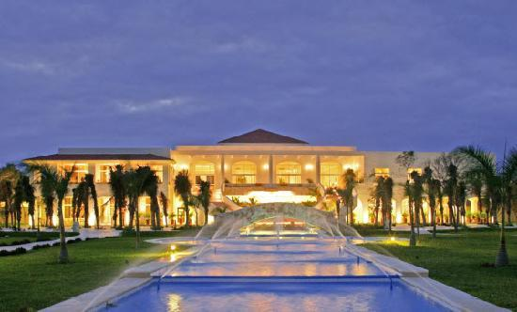

Slide 35
Company, Customer and Competitive Effects on Pricing
Company Effects
How does price affect other items, costs, profits?
As the final price is quoted, each of these has to be assessed
Customer Effects
How does price affect customer perceptions?
Competitive Effects
How will competition react?

Slide 36
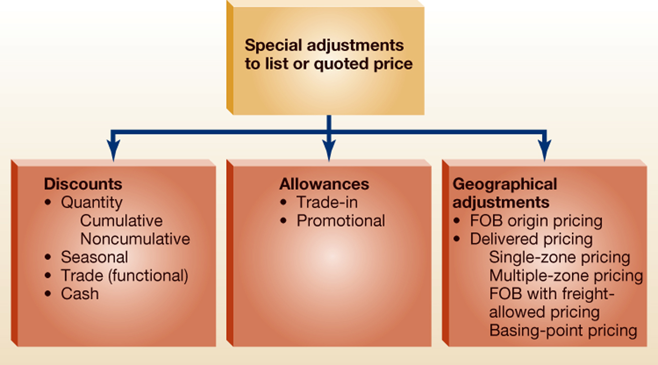
Step 6: Make Special Adjustments to List or Quoted Prices

Slide 37

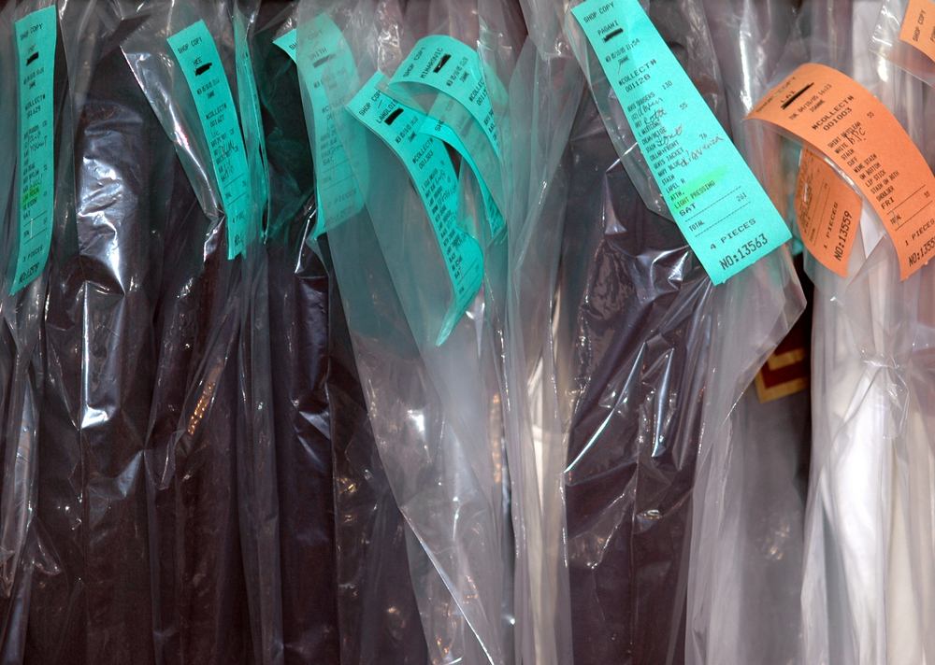


Legal Issues: Regulatory Aspects of Pricing
Price Fixing
Conspiracy across firms to set pricing across market
Price as a discriminatory tool
Different prices charged to different customers
May be justified if justified based on (1) different costs for different customers, (2) seasonal or changing market conditions and are not used to injure competition
3.5 X more
Between
$200 - $2000+
1/3 more

Slide 38
Legal Issues: Regulatory Aspects of Pricing
Price Fixing
Conspiracy across firms to set pricing across market
Price as a discriminatory tool
Different prices charged to different customers
May be justified if justified based on (1) different costs for different customers, (2) seasonal or changing market conditions and are not used to injure competition
Deceptive pricing
Misleading customers
Geographical Pricing
Could be legal if no conspiracy exists
in 1996, consumers sued VSC based on allegations that Victoria's Secret distributed different versions of its catalog that offered different prices to different customer groups for the same items.
Predatory Pricing
Setting low prices to drive out competition

Slide 39
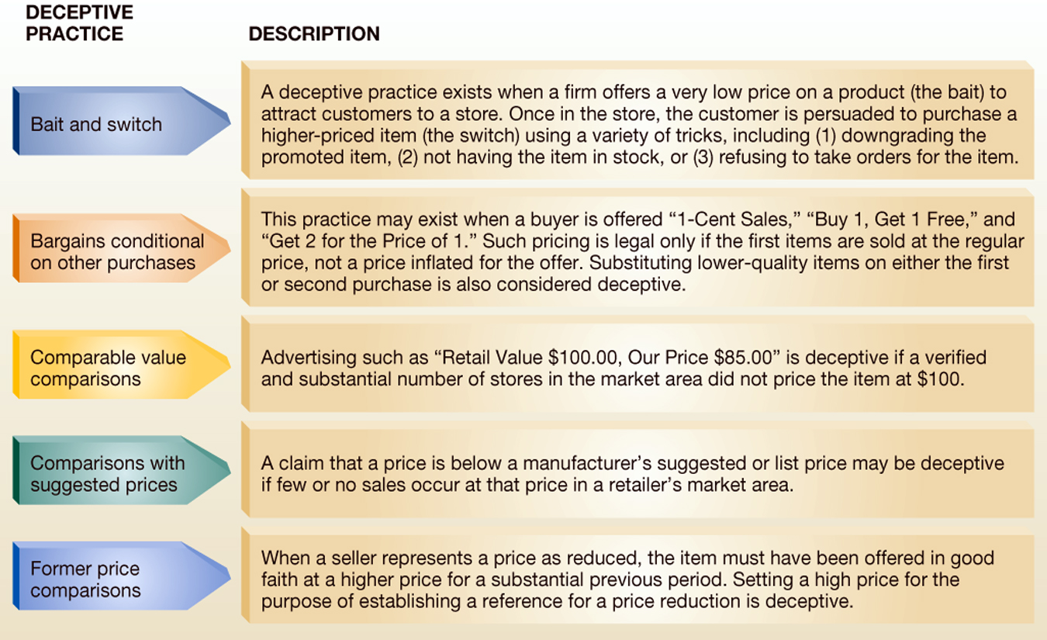
Five most common deceptive pricing practices

Slide 40
Legal Issues: Deceptive pricing
Bait and switch
You see an ad in the paper for your favorite SUV showing a monthly payment of $299 a month. It looks like a great deal, since, either according to simple math or someone you know who recently got this vehicle, the payment should be more like $500 a month. Keep in mind, people never read the fine print. You are very excited to get your new SUV for this low, low payment and show up on the lot. You mention the ad you saw in the paper. Lo and behold, the salesman regretfully informs you that the particular car has already been sold…
Conditional bargains
“Buy 1 get one 50%” – elevating the price of the first product

Slide 41
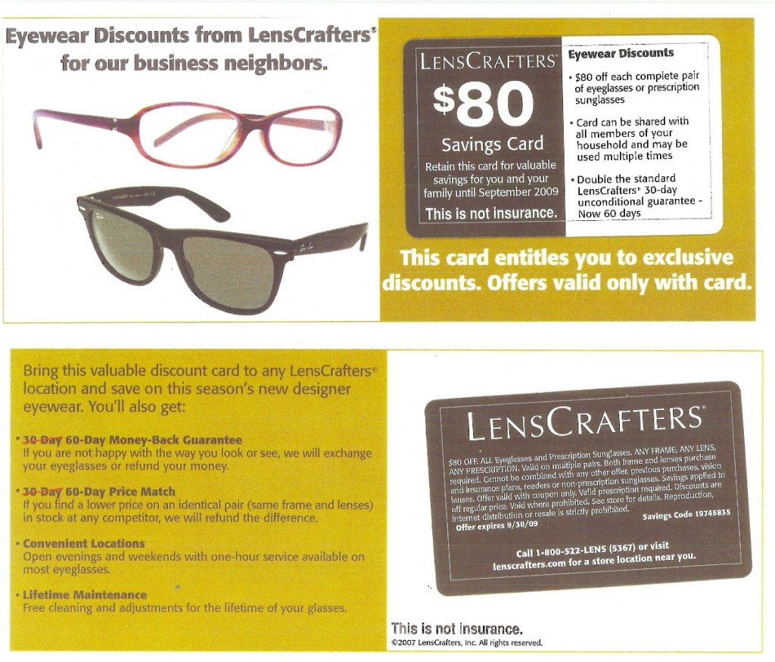
Bait And Switch
Excludes all of the fashion brands (e.g. Oakley, Maui Jim) but no mention of this in advertisement.

Slide 42
Legal Issues: Deceptive pricing…
Comparable value comparisons
Retailer Doe advertises Brand X pens as having a Retail Value $15.00, My Price $7.50,''
Comparisons with suggested prices
“Manufacturer’s suggested retail price is $10, our price $7.50”
Former price comparisons
Price based on mark up should be $7.50. The retailer sells it at $10 for a couple of weeks and then marks it down to $7.50 and advertises the “deal”

Slide 43

Legal issues: Predatory pricing
Setting very low prices to reduce competition
Example
American Airlines vs. small airlines (Vanguard, Sun Jet and Western Pacific)
Average price Dallas – Kansas City before competition = $108
Dropped to $80 with competition plus doubled number of flights
After competition gave up, fares went up to $147 and number of flights were scaled back

Slide 44
Review
What are the six steps of pricing?
What are the four approaches of setting a price?
What are the demand-oriented approaches?
What is an example of deceptive pricing?

